Slide 1
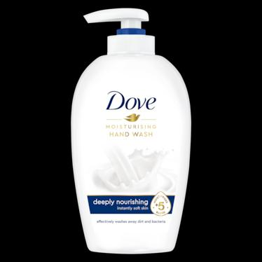
Dove
Goodbye dry skin, hello hydration. Show your body some love with our ultra-moisturizing care, hand-picked to soothe your skin as the cold weather comes in.

